Slide 1

Afera General Assembly
6 October 2016
09.00 - 09.35 hrs.
Conference Room XL
SIDE Hotel Hamburg

Slide 3
Marketing Committee
General Report - October 2016
By:
Matthias von Schwerdtner
& team: Mike, Astrid, Bathsheba,
Sharon, Louise & Bert

Slide 4
Ongoing
Content-driven (annual) conference
Outside-in & inside-out
Digital strategy: Social media and website
‘Ideas that stick’
Members recruitment
MC - Working group
Market data
Review existing studies by Feb 2017 – present @ AC
Satisfaction Survey (& SC)
Educational awareness initiative (& TC)
Regulatory affairs (& TC)

Slide 5
Annual conference 2016
Content driven:
“going fast and going slow – managing the speed of change”

Slide 6
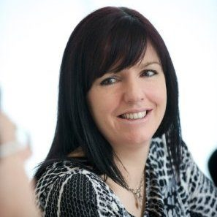
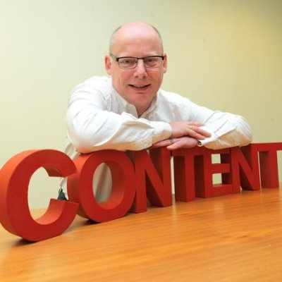
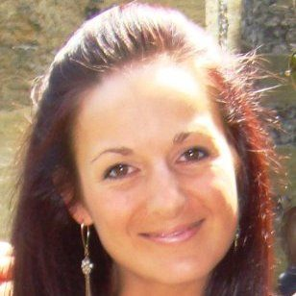
Digital: social media & website
The faces:

Slide 7

Twitter – Feb 2016

Slide 8

Twitter – Oct 2016

Slide 9
Twitter – Oct 2016
Are YOU following?
@Afera_Tape
@_ProductDesign
Yesterday our number was 2807 followers,
which compares to
@PSTC_Tape with 242 followers
@FINATcom with 856 followers
@FEICA_news with 689 followers

Slide 10
Social media and website
Integrated approach to website, SEO (search engine optimization) and social media management
(by Afera working group: Sharon, Louise, Bert, Astrid, Bathsheba)
Content coming from numerous parties (e.g. TC, MC, etc.) – “Why Tape?” will linked to Twitter followers of @_ProductDesign → to be launched in 6-8 weeks → watch out for next news letter!!

Slide 11
Social media and website
Next stage of content management:
Foundation of a LinkedIn group among MC members to share and generate additional (branded) content (both text and videos)
Hold webinar to share status of Afera activities with broader member audience (experts from your companies)
Have a professional resource to keep our content (plan) up to date

Slide 12

Membership recruitment
We generated a database of potentials
Working group (Stefan Meirsman, Melanie Lack, Stefen Neuner, Mike Watson, +) to invite potential members

Slide 13
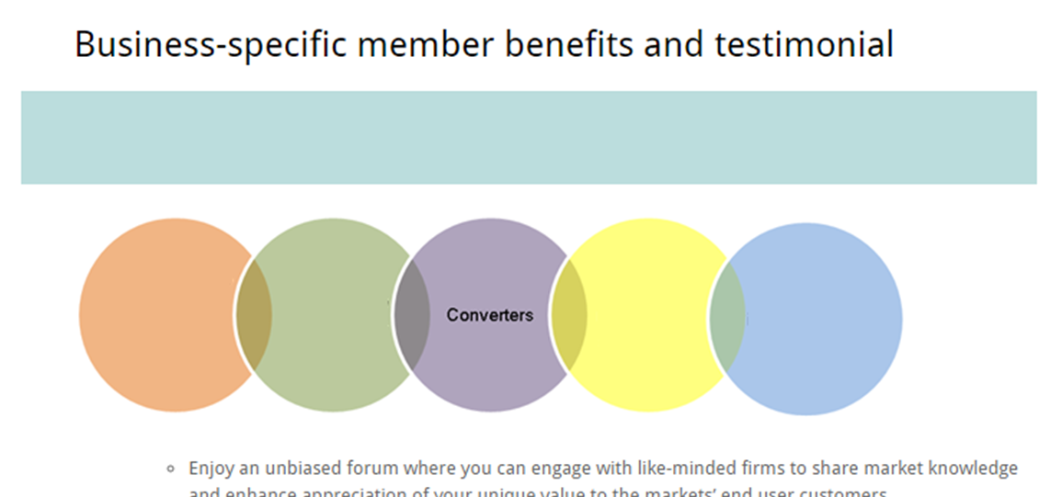
Membership recruitment supported by web page content
http://www.afera.com/about-afera/member-benefits/business-specific-member-benefits-and-testimonial.html

Slide 14
Membership satisfaction survey
60% of member response rate
Networking and (regulatory) standardization is main reason for membership
Most want Annual Conf to be held in Italy and in fall
Favorite topics: market data, economic trends, technology info and regulatory affairs most popular for papers at events

Slide 15
Market data
Regular review and analysis of existing surveys (e.g. AWA, Freedonia, MarketsAndMarkets, etc.)
Benchmarking with information form e.g. Catia
Preparation of relevant information/ latest intelligence for the annual conference → paper by internal or external partner (e.g. 2016 – Corey Reardon, AWA)

Slide 16
Annual conference 2017
Any ideas or wishes……????
Speak to any of the committee members!!
Again: internal as well as external speakers

Slide 17
Afera
Technical Committee
General Report 2016
Plans 2017
By Chairman: Evert Smit

Slide 18
Realised / Actioned 2016
Further Global Test Methods Harmonisation
  3 Methods global
  Global Tape Forum in May 2016
5 EU speakers at GTF / CATIA Beijing via Afera
  Presented Afera: “The Heart of the European Adhesive Tape Network”
Tape College 2016

Slide 19
Realised / Actioned 2016
Working Groups
  Educational Curriculum – with Marketing Committee – start in UK
  Test methods: disbanded and now Project Team on need basis
  Regulatory Focus Group
  „Why Tape?“ website overhaul
    Go-live in 6-8 weeks
Regulatory activities
  BREF running at member companies

Slide 20
ISO/CEN Activities
Global Industry Standards
  Establishment of self adhesive tape mirror committees
    All Afera/CEN TC related matters are being handled by DIN
    DIN is taking care of the renumbering of the national test methods relating to our ISO test methods.
  Status of global Industry Standards
    Newly created globally harmonised test method GTF 6001 (SAFT Test Method) has been isued
    Thickness Test Method and Width & Length Test Method are harmonised test methods, agreed at GTF: GTF 6002 and GTF 6003
  Precision and Bias Statement status
    Critical in evaluations. Tesa and Lohmann delegates

Slide 21
Regulatory Activities
Collaboration with FEICA on CoRAP SVHC candidate list sharing
  0.1% SVHC threshold – ECJ ruling
CheMI Platform defending the interests of adhesive tape
Platform will invite a representative of ECHA & EU to discuss how to interpret this ECJ ruling and how we should adopt this in guidance documents
Afera Regulatory WG (tesa, Avery, Nitto, 3M and Lohmann) met to discuss a standpoint for adhesive tapes which has been sent out

Slide 22
Regulatory Activities
BREF / ESVOC
  Member companies joined forces and responded on questionnaire via Afera
Hot topics:
  MDI (isocyanates)
  Formaldehyde
  Biocides (dispersions)
  Conflict Minerals
  …

Slide 23
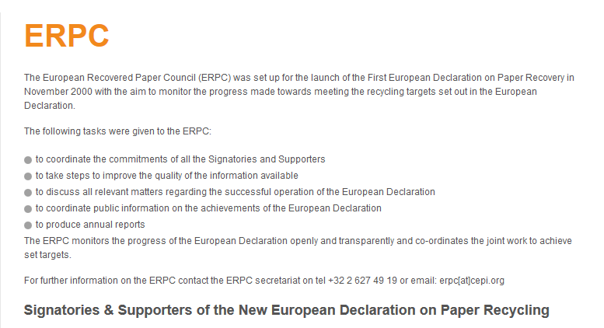
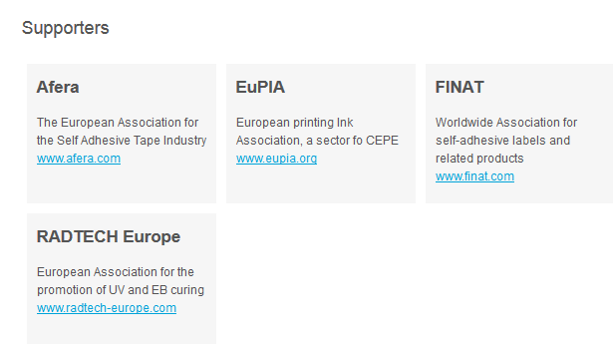
European Recovered Paper Council (ERPC)
Notes:
As you all know in early February Henkel has introduced a new corporate claim and a new corporate design.
Today I would like to give you some insights on why this change was undertaken, what will change and how the roll-out process will be.

Slide 24

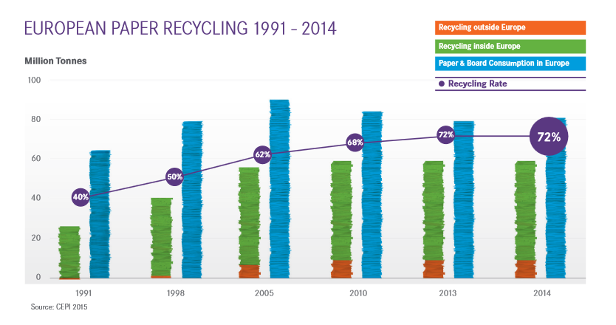
European Recovered Paper Council (ERPC)
Goal: to avoid COM regulation on paper recycling shares

Slide 25
European Recovered Paper Council (ERPC)
ERPC Monitoring Report
(Training)
Training of Afera members and/or customers regarding the influence of packaging tapes in paper recycling
  Afera Tape College
  and/or
  AFERA Technical Seminar
Notes:
As you all know in early February Henkel has introduced a new corporate claim and a new corporate design.
Today I would like to give you some insights on why this change was undertaken, what will change and how the roll-out process will be.

Slide 26
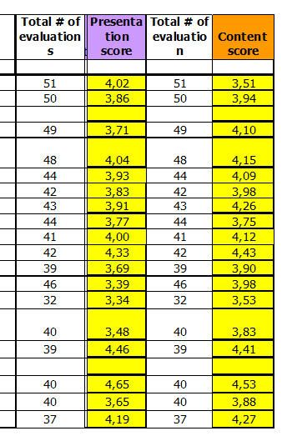
Tape College
(Brussels April 18-20)
Tape College 2016
  Goal was to increase quality, reinvigorate
  WG looked at best practice at e.g. PSTC
  Learnings from new format Technical Seminar 2015
Result:
  New format highly appreciated
  Highest ratings by the participants ever:
    Speaker score 3.92 (scale 1-5)
    Content score 4.04
Note: Immediately after Brussels Attack: reduced participation rate

Slide 27
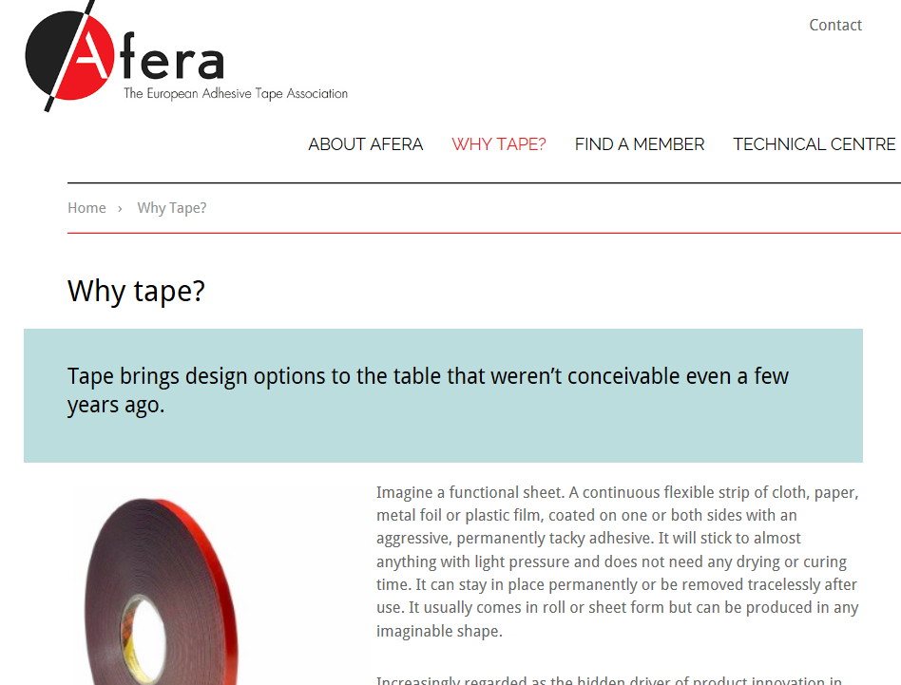
„Why Tape?“ Website section
Complete overhaul ready
Go-live in 6-8 weeks

Slide 28
Started + Plan 2017
Test methods / Standards / Intl. Coop
  Focus on accuracy, repeatability, standardisation
Regulatory activities
  Focus Group
Working Groups
  Educational Curriculum
  Tape College 2017
  International Technical Seminar 2018 plus
  Global Tape Forum 2018

Slide 29
Regulatory Activities
Agreed to use consultant to coordinate activities

Slide 30
Educational Curriculum
Raise awareness of these technologies as solutions for (engineering) students:
  Design
  Building & construction
  Automotive
  and to a lesser extend / lower priority:
  Medical
  Electronics
The effort MUST be a Afera-event
Marketing Committee driving,
TC support

Slide 31

Educational Curriculum
Get tapes on the radar screen of professors at specific universities
  initially in UK

Slide 32
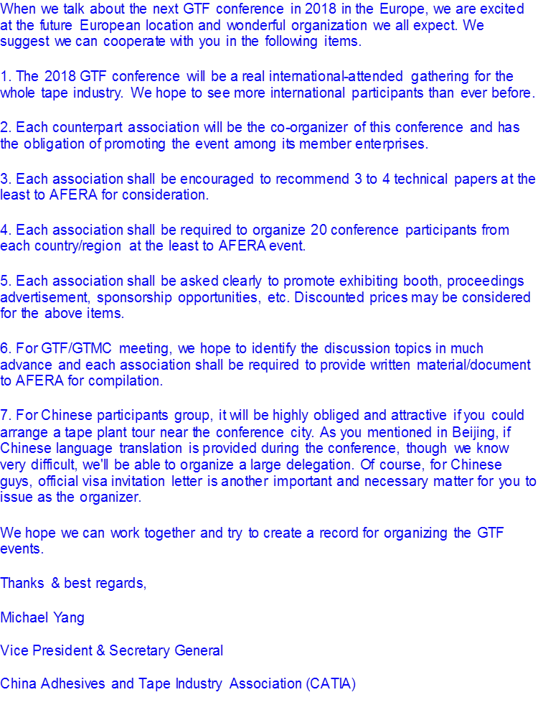
Global Tape Forum 2018
At Beijing GTF 2016 Afera agreed to organise the 2018 event in Europe
Location likely Munich
Try include plant tour
Will invite 4-5 speakers
  Americas
  Apac
Combine with Intl.
Technical Seminar
Mid April 2018

Slide 33
Technical Seminar and Tape College 2017 / 2018
International Technical Seminar moved to April 2018, combined with Global Tape Forum
Tape College instead
  Basically repeat of 2016 event
  Small improvements from feedback
  Allow those who could not join 2016 to attend
April 10-12 2017, Brussels Marriot

Slide 34
Afera
Steering Committee
General Report 2016/
Plans 2017
By President:
Mete Konuralp
Promoting the interests of the adhesive tape industry

Slide 35
Current Composition Steering Committee
Eastern Europe
Central Europe
Western Europe
Southern Europe
Chair TC
Chair MKC

Slide 36
Future Composition Steering Committee
4 members (adhesive tape manufacturer w/ adhesive coating facilities in Europe)
2 members (raw material, machine, packaging supplier and converters)
1 member (TC chairman)
1 member (MKC chairman)

Slide 37
Future Composition Steering Committee
To cover all adhesive tape industry to wider extent
The difficulty to find candidates in regional structure
Candidates may apply to our Secratariat till the end of the year
There will be a job description for SC members on our website

Slide 38
Membership Fees 2017
Due to Afera’s effective strategic direction resulting in a strong financial position, our membership fees will not be changed in 2017.

Slide 39
Financial Report
Balance Sheet 2016
Budget & Latest Estimate 2016
Budget 2017

Slide 42
For MKC
Content Management & Social Media Activity
For TC
Regulatory affairs management
€15.000 provison each for investment from Afera’s capital
in total €30.000

Slide 43
Next Events 2017

Slide 44


Slide 45
Official Opening
59th Annual Conference

